Slide 1
Architecture chaine DevOps

Slide 2


Local git repository
New sources

Slide 3

Git Push
Git/Sources
New sources

Slide 4
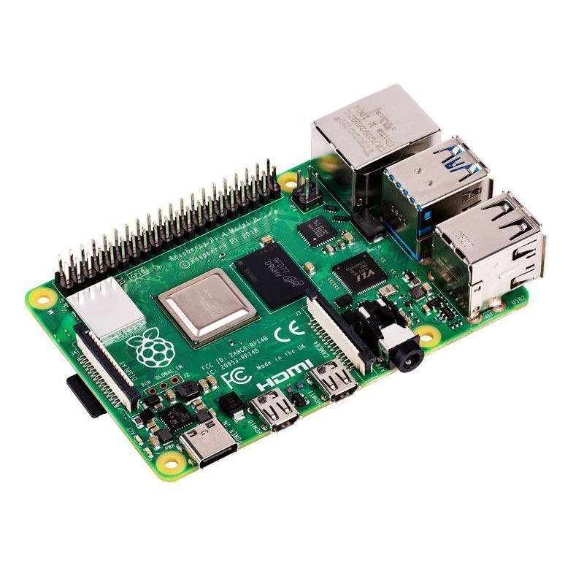

Master
Git Pull
Git/Sources
Serveur Jenkins
New sources

Slide 5



Master
Build
Git/Sources
Serveur Jenkins
New Build

Slide 6


Master
Tests
Git/Sources
New Build

Slide 7

Master
Maven Repository
Deploy
Git/Sources
Artifacts

Slide 8
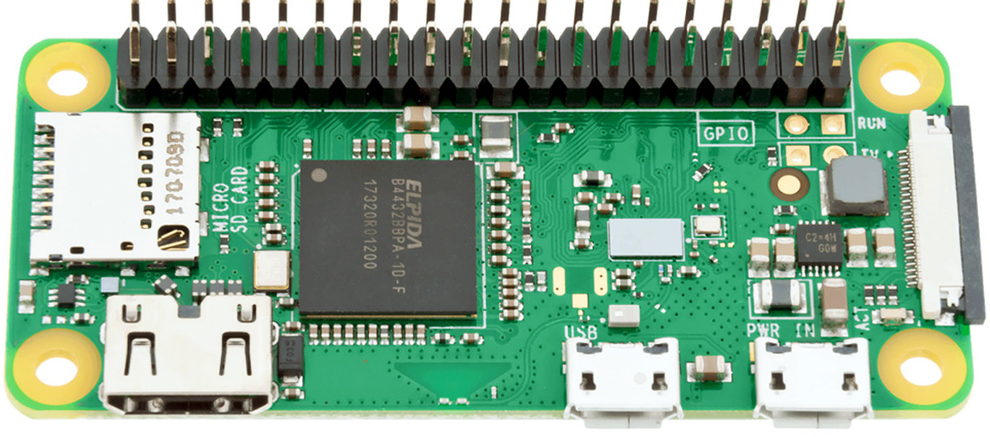

Slave
Every x hours
Local.yml
Slave
Ansible Pull
Ansible Pull
Local.yml
Slave
Ansible Pull
Local.yml
Ansible Pull
Slave
Local.yml
Local.yml

Slide 9

Slave
Local.yml
Exécute n’importe quelles modifications sur les slaves
Slave
Local.yml
Exécute n’importe quelles modifications sur les slaves
Slave
Local.yml
Exécute n’importe quelles modifications sur les slaves
Slave
Local.yml

Slide 10
Slave
Old Artifact
Upgrader.sh
Wget Latest manifest
Slave
Wget Latest manifest
Maven repository
Old Artifact
Upgrader.sh
Slave
Wget Latest manifest
Old Artifact
Wget Latest manifest
Upgrader.sh
Slave
Latest manifest
Old Artifact
Upgrader.sh

Slide 11
Slave
IF (new manifest version > old manifest Version)
Latest Artifact
Upgrader.sh
Wget Latest Artifact
Slave
Wget Latest manifest
Maven repository
Latest Artifact
Upgrader.sh
Slave
Wget Latest manifest
Latest Artifact
Wget Latest manifest
Upgrader.sh
Slave
Latest Artifact
Latest Artifact
Upgrader.sh

